Slide 1


COVID-19 pandemic in Ireland from gender+ perspective: lockdown policies, employment, and care
Alicja Bobek
RINCE Webinar TU Dublin
24 May 2022

Slide 2
Summary
RESISTIRE PROJECT AND CONTEXTUAL OVERVIEW
Project overview and methodology
COVID-19, employment and care: international literature
Gender, work and care in Ireland: pre-pandemic context
COVID-19 POLICIES IN IRELAND
Policy mapping: responses to the lockdowns
Short-term effects: work and care during COVID-19
Long-term implications: what can the current trends tell us about future impacts?
|

Slide 3









RESISTIRÉ at a glance
24 months
10 partners from 9 European countries
Research activities in EU27, Serbia, Turkey, the UK, and Iceland
A participatory approach based
on co-creation
Expected Outcomes
A new research agenda
Advocacy
Policy recommendations
Launch of pilot actions
3
|

Slide 4










Consortium
|

Slide 5
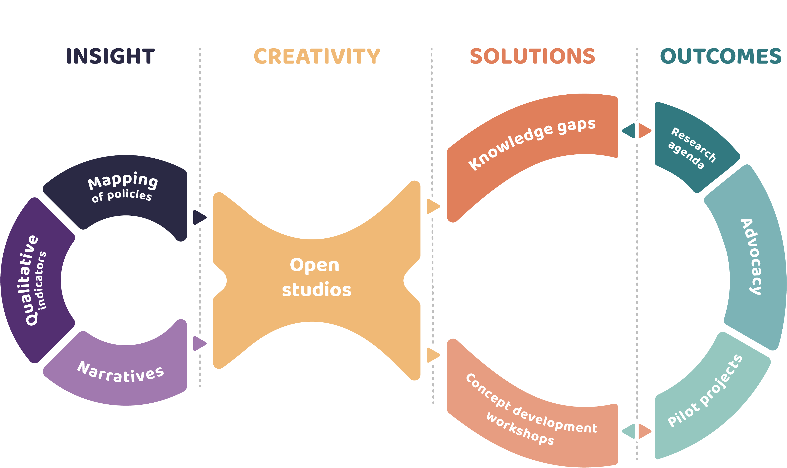
RESISTIRÉ Project Methodology
|

Slide 6

COVID-19, gender and inequalities: international evidence
COVID-19, WOMEN AND WORK
Gender as an important theme in the discussion: ‘shecession’ (Henderson, 2020), ‘pink recession’ (Matthewman and Huppatz, 2020)
Female employment affected immediately => essential work sectors and sectors impacted by public health measures (Alon et al, 2020; ILO, 2020)
COVID-19, WOMEN AND CARE WORK
Closure of schools impacting women’s paid work (Dunatchik et al., 2021; Profeta, 2020)
Work from home and care (Fergusson, 2020; Chung, 2020; Summers, 2020): Childcare to be provided with no institutional support OR elderly relatives (Blum and Dobrotic, 2021; Fodor et al., 2021)
Some shifts in the division of work (e.g. Carslon et al., 2020 for the US, Yerkes et al., 2020 for the Netherlands), but women more involved in housework (e.g. Chung et al., 2021)
|

Slide 7
COVID-19 policies in Ireland: gender, care and employment
COVID-19 LOCKDOWN STRATEGIES AND MITTIGATION POLICIES
The danger of overgeneralization: importance of the institutional context on national level (e.g., Cook and Grimshaw, 2021)
Ireland: pre-COVID-19 context, female employment and the gendered division of care: what kind of care regime?
Lockdowns and the focus of the mitigation policies: do gender regimes matter?
SHORT, MEDIUM, AND LONG-TERM IMPACT ON INTERSECTIONS BETWEEN WORK AND CARE
Impact of lockdowns on employment during COVID-19 pandemic: who was affected?
Medium and long-term effects: What are the post-COVID-19 trends in the context of the long-term shifts?
|

Slide 8
Women and employment in Ireland: overview and context
IRISH WOMEN LABOUR MARKET PARTICIPATION OVER TIME
Historically low levels of female employment (Russell et al., 2017) with rapid growth from 1980 onwards (O’Connell, 1999)
Importance of the legislative changes (e.g., marriage bar removal), tax and welfare reforms, move towards services AND shifts in the normative gender culture (e.g., O’Sullivan, 2012)
GENDERED DIVISIONS OF THE LABOUR MARKET
Persistent occupational segregation and the segregated educational system (e.g., Russell et al., 2010); vertical segregation and the ‘need to do better’ (Russel et al., 2009)
Overrepresentation of women in low paid sectors, ‘female’ and front-line jobs, and part-time employment
Women less likely to hold managerial position; culture of availability and presentism (O’Sullivan, 2012) and the burden of caring responsibilities placed on women (Bacik and Derw, 2006; Devine et al., 2011)
|

Slide 9
Female employment rates pre-COVID-19 trends: EU and Ireland (1998-2019)
|

Slide 10
Sectoral segregation: ‘male’ and ‘female’ sectors pre-COVID-19 (2019 Q4)
|

Slide 11
Occupational segregation: ‘male’ and ‘female’ dominated occupations pre-COVID-19 (2019 Q4)
|

Slide 12
Gender and care in Ireland
ELDERLY CARE
Reliance on family members (usually women) and limited involvement of public finances (e.g., Barry, 2010; Hanly and Sherin, 2017)
Private informal care for elderly multiple of that delivered through formal setting (Gannon and Davin, 2010); reliance on the market for the formal care (Barry, 2010)
CHILDCARE AND EARLY YEARS EDUCATION
Traditional low state investment in childcare (Horgan et al., 2014); childcare distinguished from early education (Hayes, 2010)
Early Childhood Care and Education (2010): ‘almost universal’ access but only for limited time and age group (Murphy, 2015); National Childcare Scheme now available but means tested and not universal
Reliance on private care providers and community sector (Russell et al., 2019); women’s care for young children (O’Sullivan, 2012)
|

Slide 13
Family carers in Ireland: growth and gender divisions
|

Slide 14
Childcare in Ireland: parents, relatives, childminders and creches
|

Slide 15
COVID-19 lockdowns in Ireland: 2020 and 2021
2020
 | Jan | Feb | Mar | Apr | May | June | July | Aug | Sep | Oct | Nov | Dec
Essential services
Construction
Retail |  |  | essential | only
Hospitality |  |  | March 15
Childcare |  |  | March 12
Schools |  |  | March 12
Work from home |  |  | March 24
2021
 | Jan | Feb | Mar | Apr | May | June | July | Aug | Sep | Oct | Nov | Dec
Essential services
Construction
Retail | essential | only
Hospitality
Childcare | essential workers only
Schools |  |  | some
Work from home
|

Slide 16
COVID-19 mitigation and support policies (1)
Code | Policy Name | Description
POL-IE01 | COVID-19 Pandemic Unemployment Payment (PUP) | Financial supports to those who lost employment as a direct result of COVID-19 pandemic (up to €350 pw)
POL-IE02 | Enhanced Illness Benefit for COVID-19 | Financial supports to those who need to self-isolate/restrict movements/cannot work due to COVID-19 (must have contract of employment or be self-employed)
POL-IE03 | COVID Restrictions Support Scheme (CRRS) | Financial support to businesses impacted by COVID-19 lockdown restrictions (up to €5000 pw)
POL-IE04 | Employment Wage Subsidy Scheme | Wage subsidy to support employers who keep their staff on payroll (payment related to gross income of each employee, flat rate €203-€350pw)
POL-IE05 | COVID-19 Stability Fund for Community, Voluntary, Charity and Social Enterprises | Support to voluntary organisations providing services to most vulnerable people (e.g. health and social care, child and family services)
|

Slide 17
COVID-19 mitigation and support policies (2)
Code | Policy Name | Description
POL-IE06 | Small Business Assistance Scheme for COVID (SBASC) | Support for business with their fixed costs (rent, utility bills etc)
POL-IE07 | Rent Supplement (COVID-19 Provisions) | Short-term income support for people in private rented sector whose income was reduced due to the COVID-19 pandemic
POL-IE08 | COVID-19 Supports for Taxi, Hackney and Limousine Operators | Aims to remove as many costs barriers as possible for the SPSV drivers to return to work
POL-IE09 | Short-Time Work Support | Available under Jobseeker’s Benefit as an income support payment for employees temporarily placed on a shorter working week due to business challenges affecting their employment
POL-IE010 | Hot School Meals Programme | Replacement for the Hot School Meals programme during COVID-19 pandemic. Available for pupils from disadvantaged communities
|

Slide 18
Mitigation policies and relevant policy domains
 | POL-IE01 | POL-IE02 | POL-IE03 | POL-IE04 | POL-IE05 | POL-IE06 | POL-IE07 | POL-IE08 | POL-IE09 | POL-IE10
Gender-based violence |  |  |  |  | ● |  | ●
Work/Labour market | ● | ● |  | ● | ● |  |  | ● | ●
Economy | ● | ● | ● | ● | ● | ● |  | ● | ●
Gender pay and pension gaps
Gender care gap |  |  |  |  | ●
Decision-making and politics
Environmental justice
Human and fundamental rights |  |  |  |  | ● |  | ● |  |  | ●
|

Slide 19
Irish government policies during COVID-19: care and unpaid work
WHAT WAS NOT ADDRESSED?
Childcare: extended closure in 2020; ‘essential’ workers only in 2021; no coverage for school-age children
Financial support for the formal childcare sector, but increased restrictions/regulations and limited services for working parents
Initial discrimination of single parents (essential shopping); women returning from maternity leave not entitled to COVID-19 payment schemes
THE GENDER DIMENSION OF WORK AND CARE?
No recognition of unpaid work and increased care needs regardless of employment status
Frontline workers: 4 months of no childcare => unpaid leave; work from home with no support for the working parents (despite the evidence that mothers’ work affected significantly)
Further disruptions => evidence of women working part/time or not going back to work
|

Slide 20
COVID-19 and family life: gender and the impact of pandemic (2020 Q2)
|
Source: CSO database, own calculations

Slide 21
COVID-19 short-term effects on employment and remote working (2020 Q2)
|
Source: CSO database, own calculations

Slide 22
COVID-19 and employment: long-term context and short-term impact
|
Source: Eurostat database, own calculations

Slide 23
COVID-19 and employment: long-term trends in part-time work for women
|
Source: CSO database, own calculations

Slide 24
COVID-19 and employment: parenthood as an important factor?
|
Source: CSO database, own calculations

Slide 25

Intersectional impact on employment: COVID-19, long term trends and country of birth
|

Slide 26
Intersectional impact on employment: COVID-19, long term trends and education
|

Slide 27
Horizontal segregation: what would the long-term effects look like?
|

Slide 28
Conclusion: The future impacts?
POSITIVE IMPACTS
The recognition of the importance of care and care work (‘formal’ setting)
More funding provided for the childcare sector
The promise of flexible working arrangements (home working and hybrid work)
NEGATIVE IMPACTS
The cultural context: care remains as a ‘female’ domain; no acknowledgement of the informal forms of care; limited discussion beyond the need to improve the childcare sector
Assumption that work from home equals time for providing care?
COVID-19 consequences for the childcare sector: fewer places available
IMPLICATIONS FOR THE FUTURE?
Long-term trends (and the importance of ‘cultural’ and institutional context) vs short-term impact!
|

Slide 29
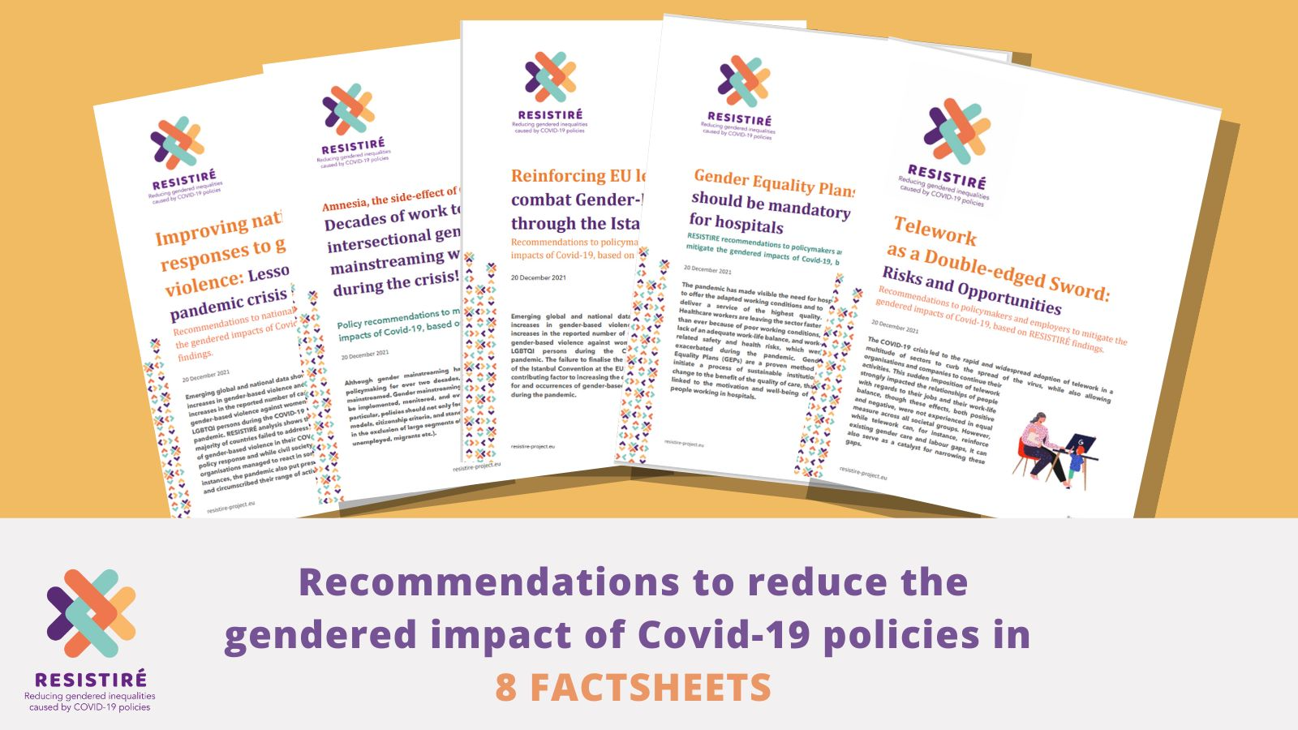

Slide 30

“There is always a better story than the better story” Dina Georgis
Within RESISTIRE, we borrow Dina Georgis’ concept of the “better story” to highlight promising practices that contribute to moving forward towards greater equality in particular contexts.
This is not a search for a “perfect fix for all” but an invitation to identify, highlight and learn from the better stories of policy and civic responses to the pandemic emerging from different contexts, as well as an invitation to imagine even better stories of responding to this crisis.
How can a gender+ perspective help us explore, make visible and co-create more egalitarian, more inclusive policies, initiatives and practices?

Slide 31
Thank you!
https://resistire-project.eu
Twitter: @resistire_eu
LinkedIn: Resistiré

